Slide 1

Event Sync
JG University | BCA – Semester 5 | Division-E

Slide 2
Team Members
Fahad Shaikh (1452) (TL)
Krish Gohil (1416)
Harsh Darji (1417)
Ikrama kathiyara (1426)
Rudra Padhiyar (1437)

Slide 3
Introduction
EventSync is a web-based event management system designed to simplify the process of managing, scheduling, and tracking events.
Built using Node.js and MySQL, the system provides a structured and secure platform for users to create accounts, log in, and interact with event-related services.

Slide 4
Objectives
To create a secure and user-friendly platform for event management.
To allow users to register, authenticate, and manage their accounts.
To facilitate event creation, scheduling, and tracking.
To integrate a relational database (MySQL) for storing user and event data.
To provide administrators with oversight of user activities.

Slide 5
Existing System
Traditional event management often relies on manual processes or fragmented tools, which can lead to inefficiencies, miscommunication, and security issues.
Existing solutions are either too complex for small organizations or lack robust user management.
Drawback of Existing System :
Manual record keeping prone to errors.
Lack of centralized user authentication.
Difficulty in managing event data securely.
Limited scalability and adaptability to different use cases.
MAJOR: INTERIOR DESIGN

Slide 6
Proposed System
The proposed EventSync system overcomes these limitations by offering a secure, scalable, and centralized platform for event management.
Using modern web technologies, the system ensures smooth interaction between users and administrators, while maintaining data security with password encryption and database integration.
Features :
User registration and authentication.
Secure password handling with bcrypt.js.
Centralized event management and scheduling.
Database-driven design with MySQL.
Role-based user access (admin, registered user).
Responsive and accessible web interface.
MAJOR: INTERIOR DESIGN

Slide 7
System Users
The system is primarily designed for two categories of users :
Administrators
Regular Users
.
Role of Users :
.
Administrators - Manages users, monitors activities, and oversees the overall event process.
Registered Users - Can log in, view, and manage personal event activities.
Guest - Limited access to publicly available event information.
MAJOR: INTERIOR DESIGN

Slide 8
Modules & Sub Modules
User Module
User registration
Login/logout functionality
Session management.
Database Module
Create and update events
Event scheduling
Event tracking.
MAJOR: INTERIOR DESIGN

Slide 9
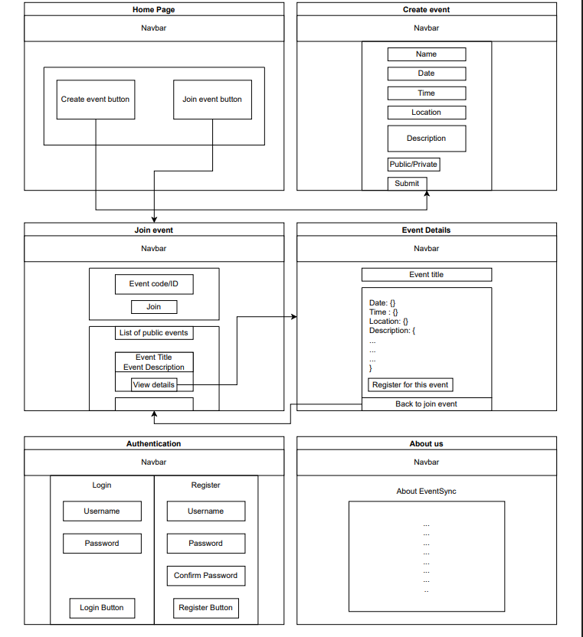
System Design
(Wireframe)

Slide 10
Data Dictionary
User
User_id | INT | NOT_NULL | PRIMARY_KEY | Unique identifier for each user.
Name | VARCHAR(100) | NOT_NULL | - | Full name of the user.
Email | VARCHAR(100) | NOT_NULL | UNIQUE | Unique email address.
Password | VARCHAR(50) | NOT_NULL | - | Encrypted user password.
Role | ENUM(‘Attendee’,’Organize’) | NOT_NULL | DEFAULT(‘Attendee’) | Defines user role (Attendee, Organizer).
Created_At | TIMESTAMP | NOT_NULL | DEFAULT(CURRENT_TIMESTAMP) | Record creation timestamp.
MAJOR: INTERIOR DESIGN

Slide 11
Event
Event_id | INT | NOT_NULL | PRIMARY_KEY | Unique identifier for each event (Primary Key).
Organizer_id | INT | NOT_NULL | FOREIGN_KEY User(User_id) | Reference to the user who organizes the event (Foreign Key).
Category_id | INT | NOT_NULL | FOREIGN_KEY Category(Category_id) | Category of the event
Title | VARCHAR(225) | NOT_NULL | - | Name of the event.
Description | TEXT | NOT_NULL | - | Details about the event.
Location | VARCHAR(225) | NOT_NULL | - | Place where the event is held.
Date | DATE | NOT_NULL | - | Scheduled date of the event.
Start_Time | TIME | NOT_NULL | - | Start time of the event.
End_Time | TIME | NOT_NULL | - | Close time of the event.
Is_Public | BOOLEAN | NOT_NULL | DEFAULT(TRUE) | Defines if the event is public or private (default = public).
Created_At | TIMESTAMP | NOT_NULL | DEFAULT(CURRENT_TIMESTAMP) | Timestamp when the event record was created.
MAJOR: INTERIOR DESIGN

Slide 12
Event_Registration
Registration_id | INT | NOT_NULL | PRIMARY_KEY | Unique identifier for each registration (Primary Key).
Event_id | INT | NOT_NULL | FOREIGN_KEY Event(Event_id) | Reference to the event being registered (Foreign Key).
User_id | INT | NOT_NULL | FOREIGN_KEY User(User_id) | Reference to the user who registered (Foreign Key).
Date_&_Time | DATETIME | NOT_NULL | - | Scheduled date & time of the event.
Registration_Time | TIMESTAMP | NOT_NULL | DEFAULT(CURRENT_TIMESTAMP) | Timestamp when the registration was made (default = current time).
Tickets
Ticket_id | INT | NOT_NULL | PRIMARY_KEY | Unique identifier for each ticket (Primary Key).
Registration_id | INT | NOT_NULL | FOREIGN_KEY Event_Registration (Registration_id) | Links the ticket to an event registration (Foreign Key).
Ticket_code | INT | NOT_NULL | UNIQUE | Unique code assigned to the ticket.
Issued_At | TIMESTAMP | NOT_NULL | DEFAULT(CURRENT_TIMESTAMP) | Timestamp when the ticket was issued (default = current time).
MAJOR: INTERIOR DESIGN

Slide 13
Contact_Message
Contact_message_id | INT | NOT_NULL | PRIMARY_KEY | Unique identifier for each contact message
Name | VARCHAR(100) | NOT_NULL | - | Name of the person sending the message.
Email | VARCHAR(100) | NOT_NULL | - | Email address of the sender.
Message | TEXT | NOT_NULL | - | The actual message content.
Sent_At | TIMESTAMP | NOT_NULL | DEFAULT(CURRENT_TIMESTAMP) | Timestamp when the message was sent (default = current time).
Category
Category_id | INT | NOT_NULL | PRIMARY_KEY | Unique identifier for each category (Primary Key).
Name | VARCHAR(100) | NOT_NULL | UNIQUE | Name of the category (must be unique).
MAJOR: INTERIOR DESIGN

Slide 14
Sessions
Session_id | INT | NOT_NULL | PRIMARY_KEY | Unique identifier for each session (Primary Key).
Event_id | INT | NOT_NULL | FOREIGN_KEY Event(Event_id) | Reference to the related event (Foreign Key).
Title | VARCHAR(100) | NOT_NULL | - | Name or title of the session.
Speaker | VARCHAR(100) | NOT_NULL | - | Person presenting the session.
Start_Time | TIME | NOT_NULL | - | Time when the session begins.
End_Time | TIME | NOT_NULL | - | Time when the session ends.
MAJOR: INTERIOR DESIGN

Slide 15
Notification
Notification_id | INT | NOT_NULL | PRIMARY_KEY | Unique identifier for each notification (Primary Key).
User_id | INT | NOT_NULL | FOREIGN_KEY User(User_id) | Reference to the user receiving the notification (Foreign Key).
Event_id | Int | NOT_NULL | FOREIGN_KEY Event(Event_id) | Reference to the event receiving the notification (Foreign Key).
Message | TEXT | NOT_NULL | - | The notification content or text.
Sent_At | TIMESTAMP | NOT_NULL | DEFAULT(CURRENT_TIMESTAMP) | Timestamp when the notification was sent (default = current time).
Feedback
Feedback_id | INT | NOT_NULL | PRIMARY_KEY | Unique identifier for each feedback (Primary Key).
Event_id | INT | NOT_NULL | FOREIGN_KEY Event(Event_id) | Reference to the event which the user attended
Name | VARCHAR(100) | NOT_NULL | - | Stores the user's name; must be unique and not null (Primary Key).
Phone_No. | INT(32) | NOT_NULL | - | Stores a 32-bit integer for the user's phone number; required field
Email | VARCHAR(100) | NOT_NULL | - | Stores the user's email address; cannot be null.
Comment | TEXT | NOT_NULL | - | Stores feedback or comments from the user; must be provided.
MAJOR: INTERIOR DESIGN

Slide 16
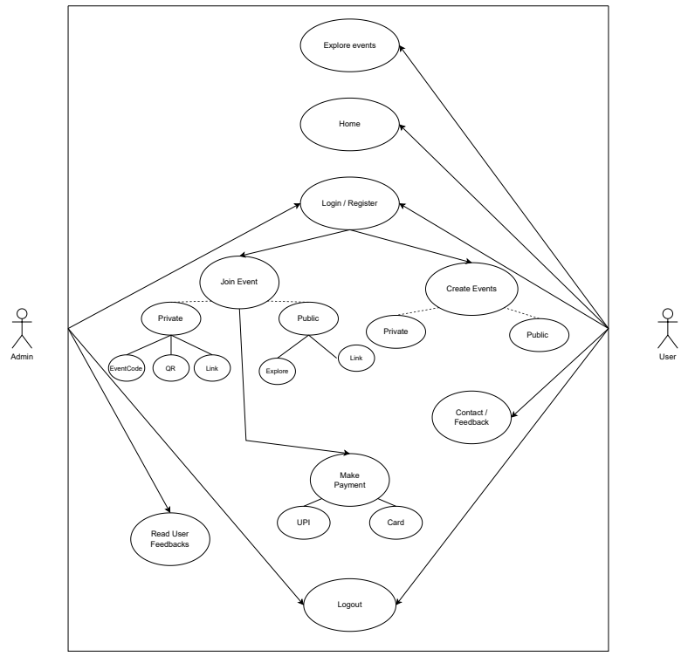
UML Diagrams
Use Case :

Slide 17
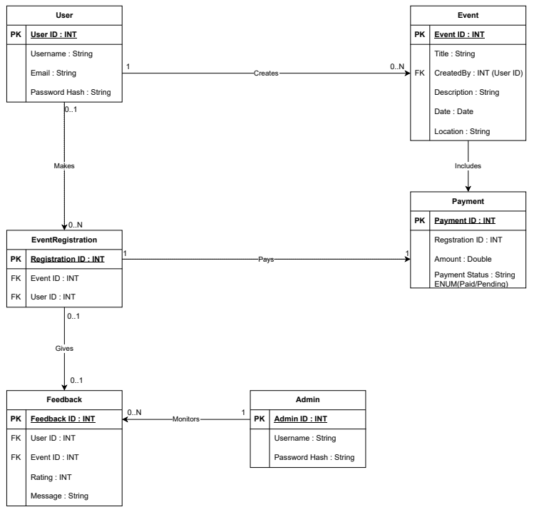
Class Diagram :

Slide 18
THANK YOU

